Slide 1
Experiments in Economics Lecture 6
Analysing the data from the experiment

Slide 2
Analysing the data from the experiment
If you have organised the experimental software well, then the data will be in one or more Excel data files (or something similar).
There will be a row for each decision, and perhaps other rows giving more information (with data in the columns reminding you what is in the rows).
You will be able to analyse the data with a variety of softwares, depending upon what you want to do with it.
Softwares include Excel (if you must!), Stata, R, Maple, Matlab.

Slide 3
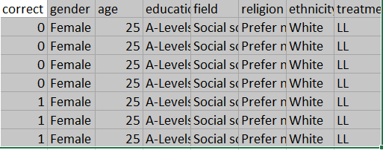
An example of part of a datafile From the experiment which did not collect all relevant data.

Slide 4
Analysing the data from the experiment
This very much depends upon what the objective of the experiment is.
In lecture 1 I mentioned the following types of experiment:
Observing – just seeing what happens
Testing the assumptions
Testing the conclusions
Estimating – fitting models to data, and getting estimates of key parameters.
Predicting
How you should analyse the data depends on the objective.

Slide 5
Observing – just seeing what happens
You just need to report the data in tables and/or figures.
Some summary statistics would be useful.
For example, if you wanted to see if women behave differently from men, and you were measuring their risk attitude, you should have a summary stating the mean risk-aversion for men and that for women.
You could report a simple mean, a standard deviation or a histogram.
What is crucial is that it gives a clear and unbiased portrayal of your main findings.
You could standard significance tests as to whether one mean is equal to some other mean.

Slide 6
A note on significance tests
These are purely statistical, the results of which depend upon the number of observations that you have and the amount of noise in the data.
An insignificant test does not tell you that there is no difference (between the means), only that you do not have enough data and there is too much noise.
A significant test tells you a lot more.
I would prefer you to look at economic importance rather than statistical significance.

Slide 7
Testing the assumptions
The assumptions will almost certainly be axioms
“All axioms are wrong”.
With individual data you can calculate the proportion of times a decision was taken which violated some axiom.
Testing whether this is significantly different from zero is pointless.

Slide 8
Testing the conclusions
Again you could do comparative static tests.
But please note my previous remarks about significance.

Slide 9
Estimation
This is my preferred use of the data.
Presumably, driving the research is one or more models of behaviour in the experiment.
I would fit the models to the data and estimate any parameters of the models.
I would fit using maximum likelihood.
You would need to make some assumptions about noise (the stochastic nature of the data).
One could compare the maximised (corrected) log-likelihoods to see which model best explains the data.
You could always include in the set of models being tested one that says that subjects behave randomly.

Slide 10
Prediction
I feel that this is the ultimate test of an experiment.
One can only do predictions if one has estimated (fitted) the models.
Otherwise one just gets vague comparative static predictions.
I would suggest using part of the data for estimation and the rest for predictions.
Fit the models on one part, get the estimated parameters and use them to predict behaviour on the other part.
One can then see which model predicts the best.
There are obviously going to be problems about noise.

Slide 11
That is the end of Lecture 6.
Thank you for your attention.

